Slide 1
CSE 205: Digital Logic Design

Slide 2
Textbook
Digital Design (5th Edition)
M. Morris Mano
Michael D. Ciletti

Slide 3
Digital Systems
Why study digital logic design
To design and build a digital system
Digital Systems
Example: digital cameras, digital telephones, digital television, digital computers…
Used in communication, business transactions, traffic control, space guidance, medical treatment, weather monitoring, the Internet …

Slide 4
Binary Logic
In a digital system, all signals take on discrete values.
Also referred as states
Most modern digital systems operate on 2 discrete states
Binary logic system
Deals with binary variables and a set of logical operations

Slide 5
Binary Logic
We represent the two states of binary variable as
True and false
1 and 0
High and Low
Three basic logic operations
AND: x.y = z or xy = z
OR: x + y = z
NOT: x’ = z or x = z

Slide 6
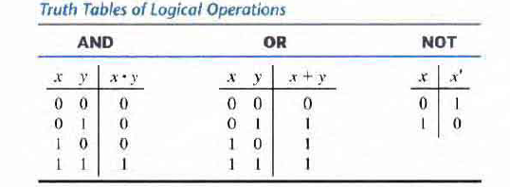
Truth Table
Specifies results for all possible input combinations

Slide 7
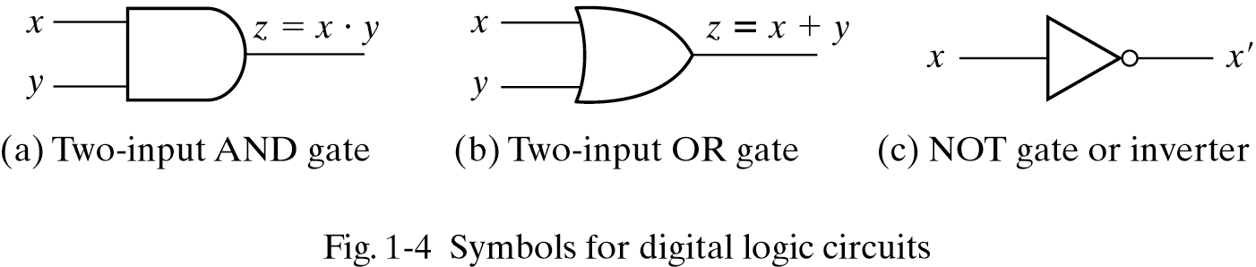
Logic Gates
Logic gates are electronic circuits that operate on one or more input signals to produce an output signal.

Slide 8
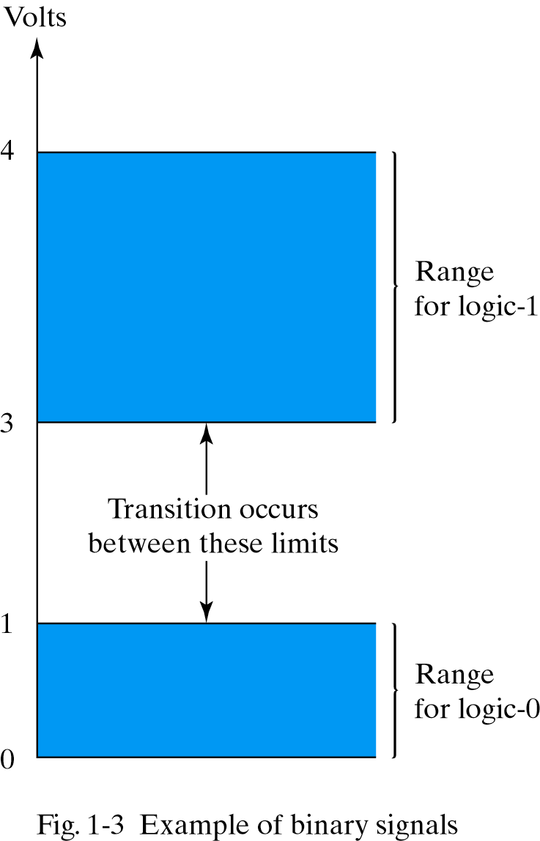
Logic Gates

Slide 9
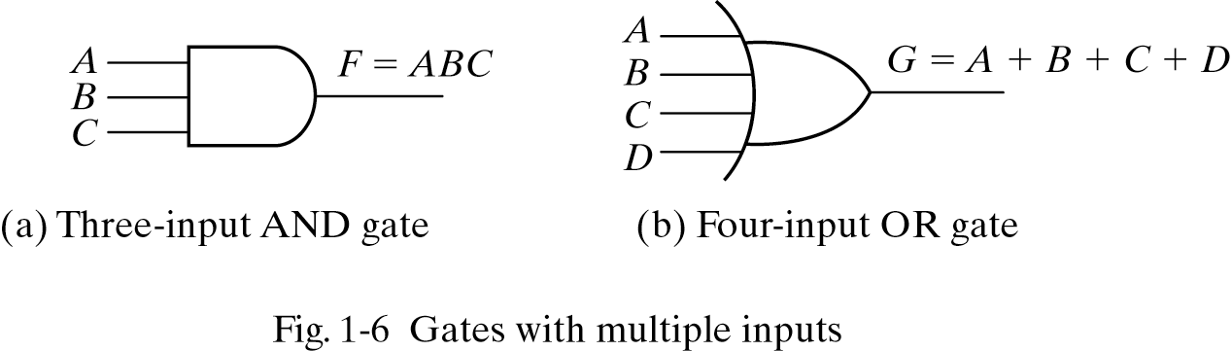
Logic Gates

Slide 10
Boolean Function
An algebraic expression
Binary variables
Constants 0 and 1
Logic operation symbols
f(x,y,z) = (x + y’)z + x’
Some terminology, notation and precedence:
f is the name of the function.
(x,y,z) are the input variables, each representing 1 or 0.
A literal is a single variable within a term, in complemented or uncomplemented form. The function above has four literals: x, y’, z, and x’.
Parenthesis has the highest precedence, followed by NOT, AND, and then OR.

Slide 11
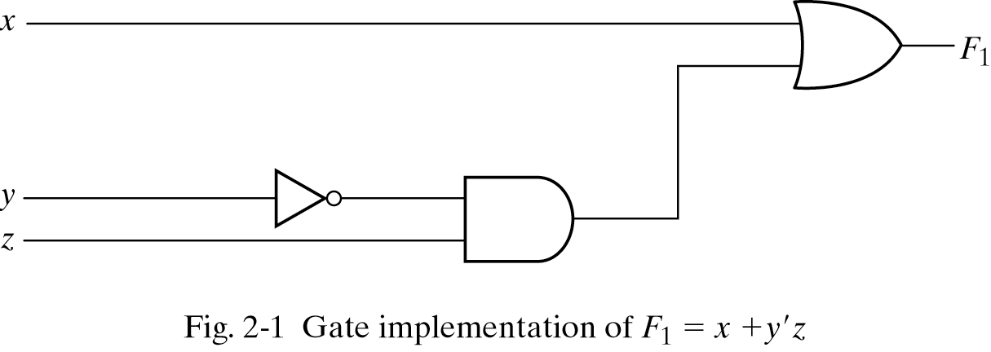
Gate Implementation of a Function

Slide 12
Gate Implementation of a Function
f(x,y,z) = x’ + y
x
x+y

Slide 13
Gate Implementation of a Function
_______
f(x,y,z) = (x + y)x
x+y
x+y
(x+y)x

Slide 14
Boolean Function
A Boolean function can be represented in a truth table.
f(x,y,z) = (x + y’)z + x’
f(0,0,0) = (0 + 1)0 + 1 = 1
f(0,0,1) = (0 + 1)1 + 1 = 1
f(0,1,0) = (0 + 0)0 + 1 = 1
f(0,1,1) = (0 + 0)1 + 1 = 1
f(1,0,0) = (1 + 1)0 + 0 = 0
f(1,0,1) = (1 + 1)1 + 0 = 1
f(1,1,0) = (1 + 0)0 + 0 = 0
f(1,1,1) = (1 + 0)1 + 0 = 1

Slide 15
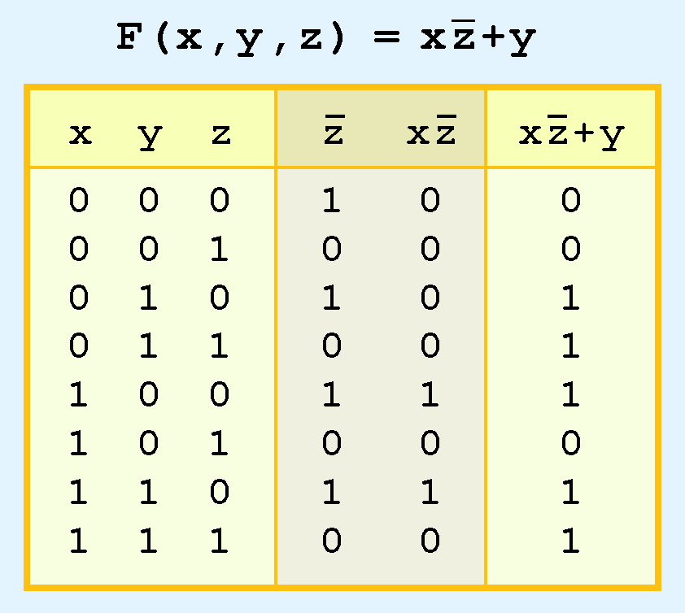
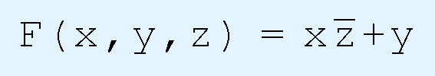
Boolean Function
A Boolean function can be represented in a truth table.

Slide 16
Number Systems
Consists of TWO Things:
A BASE or RADIX Value
A SET of DIGITS
Digits are symbols representing all values less than the radix value.
Example is the Common Decimal System:
RADIX (BASE) = 10
Digit Set = {0, 1, 2, 3, 4, 5, 6, 7, 8, 9}

Slide 17
Decimal Number Systems
Consider: 5032.21
Other Notation: (5032.21)₁₀
In general, a number expressed in a base-r system has coefficients multiplied by powers of r:
a
⋅r +a
⋅r +…+a
⋅r +a
+a
⋅r +a
⋅r +…+a
⋅r
n
n-1
1
-1
-2
-m
n n-1 1 0 -1 -2 -m

Slide 18
Other Number Systems
Binary
Radix = (2)₁₀
Digit Set = {0,1}
Octal
Radix = (8)₁₀
Digit Set = {0,1,2,3,4,5,6,7}
Hexadecimal
Radix = (16)₁₀
Digit Set = {0,1,2,3,4,5,6,7,8,9,A,B,C,D,E,F}

Slide 19
Binary Number Systems
Binary
Radix = (2)₁₀
Digit Set = {0,1}
Binary to Decimal:

Slide 20
Binary to Decimal: practice
6 ₁₀
0110 ₂ = ?
11010 ₂ = ?
0110101 ₂ = ?
11010011 ₂ = ?
26 ₁₀
53 ₁₀
211 ₁₀

Slide 21
Octal Number Systems
Octal
Radix = (8)₁₀
Digit Set = {0,1,2,3,4,5,6,7}
Octal to Decimal:

Slide 22
Hexadecimal Number Systems
Hexadecimal
Radix = (16)₁₀
Digit Set = {0,1,2,3,4,5,6,7,8,9,A,B,C,D,E,F}
Hexadecimal to Decimal:

Slide 23
Decimal (Integer) to Binary
Divide the number by the ‘Base’ (=2)
Take the remainder (either 0 or 1) as a coefficient
Take the quotient and repeat the division
Example: (13)₁₀
Quotient
Remainder
Coefficient
13
/ 2 = 6
1 a₀ = 1
6
/ 2 = 3
0 a₁ = 0
3
/ 2 = 1
1 a₂ = 1
1
/ 2 = 0
1 a₃ = 1
Answer: (13)₁₀ = (a₃ a₂ a₁ a₀)₂ = (1101)₂
MSB LSB

Slide 24
Decimal to binary: practice
1 1 0 1 ₂
13₁₀ = ?
22₁₀ = ?
43₁₀ = ?
158₁₀ = ?
1 0 1 1 0 ₂
1 0 1 0 1 1 ₂
1 0 0 1 1 1 1 0 ₂

Slide 25
Decimal (Fraction) to Binary
Multiply the number by the ‘Base’ (=2)
Take the integer (either 0 or 1) as a coefficient
Take the resultant fraction and repeat the division
Example: (0.625)₁₀
Integer
Fraction
Coefficient
0.625
* 2 = 1 . 25
a₋₁ = 1
0.25
* 2 = 0 . 5 a₋₂ = 0
0.5
* 2 = 1 . 0 a₋₃ = 1
Answer: (0.625)₁₀ = (0.a₋₁ a₋₂ a₋₃)₂ = (0.101)₂
MSB LSB

Slide 26
Decimal to Octal Conversion
Example: (175)₁₀
Quotient
Remainder
Coefficient
175
/ 8 = 21
7 a₀ = 7
21
/ 8 = 2
5 a₁ = 5
2
/ 8 = 0
2 a₂ = 2
Answer: (175)₁₀ = (a₂ a₁ a₀)₈ = (257)₈
Example: (0.3125)₁₀
Integer
Fraction
Coefficient
0.3125
* 8 = 2 . 5
a₋₁ = 2
0.5
* 8 = 4 . 0 a₋₂ = 4
Answer: (0.3125)₁₀ = (0.a₋₁ a₋₂ a₋₃)₈ = (0.24)₈

Slide 27
Binary − Octal Conversion
8 = 2³
Each group of 3 bits represents an octal digit
Octal | Binary
0 | 0 0 0
1 | 0 0 1
2 | 0 1 0
3 | 0 1 1
4 | 1 0 0
5 | 1 0 1
6 | 1 1 0
7 | 1 1 1
Example:
Assume Zeros
( 1 0 1 1 0 . 0 1 )₂
( 2 6 . 2 )₈
Works both ways (Binary to Octal & Octal to Binary)

Slide 28
Binary − Hexadecimal Conversion
16 = 2⁴
Each group of 4 bits represents a hexadecimal digit
Hex | Binary
0 | 0 0 0 0
1 | 0 0 0 1
2 | 0 0 1 0
3 | 0 0 1 1
4 | 0 1 0 0
5 | 0 1 0 1
6 | 0 1 1 0
7 | 0 1 1 1
8 | 1 0 0 0
9 | 1 0 0 1
A | 1 0 1 0
B | 1 0 1 1
C | 1 1 0 0
D | 1 1 0 1
E | 1 1 1 0
F | 1 1 1 1
Example:
Assume Zeros
( 1 0 1 1 0 . 0 1 )₂
( 1 6 . 4 )₁₆
Works both ways (Binary to Hex & Hex to Binary)

Slide 29
Octal − Hexadecimal Conversion
Convert to Binary as an intermediate step
Example:
( 2 6 . 2 )₈
Assume Zeros
Assume Zeros
( 0 1 0 1 1 0 . 0 1 0 )₂
( 1 6 . 4 )₁₆
Works both ways (Octal to Hex & Hex to Octal)

Slide 30
Binary Addition
1
1
1
1
1
1
1
1
1
1
0
1
= 61
= 23
+
1
0
1
1
1
1
0
1
0
1
0
0
= 84
≥ (2)₁₀

Slide 31
Binary Subtraction
1
2
= (10)₂
0
2
2
0
0
2
1
0
0
1
1
0
1
= 77
= 23
−
1
0
1
1
1
0
1
1
0
1
1
0
= 54

Slide 32
Complements
They are used to simplify the subtraction operation
Two types (for each base-r system)
Diminishing radix complement (r-1’s complement)
Radix complement (r’s complement)
For n-digit number N
r-1’s complement
r’s complement

Slide 33
Diminished Radix Complement
Example for 6-digit decimal numbers:
9’s complement is (r^{n} – 1)–N = (10⁶–1)–N = 999999–N
9’s complement of 546700:
999999–546700 = 453299
Example for 7-digit binary numbers:
1’s complement is (r^{n} – 1) – N = (2⁷–1)–N = 1111111–N
1’s complement of 1011000:
1111111–1011000 = 0100111

Slide 34
Radix Complement
The r's complement of an n-digit number N in base r is defined as r^{n} – N for N ≠ 0 and as 0 for N = 0.
The r's complement can also be obtained by adding 1 to the (r − 1) 's complement, since
r^{n} – N = [(r^{n} − 1) – N] + 1.
Decimal Number: 10^{n} - N
Example: 10’s complement of 246700 is 753300

Slide 35
Radix Complement (Binary Number)
Take 1’s complement then add 1
OR
Toggle all bits to the left of the first ‘1’ from the right
Example:
1 0 1 1 0 0 0 0
0 1 0 0 1 1 1 1
+ 1
1 0 1 1 0 0 0 0
0 1 0 1 0 0 0 0
0
1
0
1
0
0
0
0

Slide 36
Subtraction with Complements
M – N
Add M to r’s complement of N
Sum = M+(r^{n} – N) = M – N+ r^{n}
If M > N, Sum will have an end carry r^{n} , discard it
If M<N, Sum will not have an end carry and
Sum = r^{n} – (N – M) (r’s complement of N – M)
So M – N = – (r’s complement of Sum)

Slide 37
Subtraction with Complements
65438 - 5623
65438
10’s complement of 05623 +94377
159815
Discard end carry 10⁵ -100000
Answer 59815

Slide 38
Subtraction with Complements
5623 - 65438
05623
10’s complement of 65438 +34562
40185
There is no end carry.
Therefore, the answer is:
– (10's complement of 40185) = − 59815.

Slide 39
Subtraction with Complements
10110010 - 10011111
10110010
2’s complement of 10011111 +01100001
100010011
Discard end carry 2^8 - 100000000
Answer 00010011

Slide 40
Subtraction with Complements
10011111 -10110010
10011111
2’s complement of 10110010 +01001110
11101101
There is no end carry.
Therefore, the answer is
Y – X = − (2's complement of 11101101) = − 00010011.

Slide 41
Subtraction with Complements
Subtraction of unsigned numbers can also be done by means of the (r − 1)'s complement.
Remember that the (r − 1) 's complement is one less then the r's complement.
10110010 - 10011111
10110010
1’s complement of 10011111 +01100000
100010010
End-around carry + 1
Answer 00010011

Slide 42
Subtraction with Complements
10011111 -10110010
10011111
1’s complement of 10110010 +01001101
11101100
There is no end carry.
Therefore, the answer is
Y – X = − (1's complement of 11101100) = − 00010011.

Slide 43
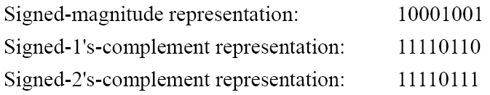
Signed Binary Numbers
To represent negative integers, we need a notation for negative values.
It is customary to represent the sign with a bit placed in the leftmost position of the number since binary digits.
The convention is to make the sign bit 0 for positive and 1 for negative.
Example:

Slide 44
Signed Binary Numbers Arithmetic Addition
Discard
+ 5 00000101
+11 00001011
+16 00010000
- 5 11111011
+11 00001011
+6 100000110
+ 5 00000101
-11 11110101
-6 11111010
- 5 11111011
-11 11110101
-16 111110000
Discard

Slide 45
Signed Binary Numbers Arithmetic Subtraction
In 2’s-complement form:
Example:
Take the 2’s complement of the subtrahend (including the sign bit) and add it to the minuend (including sign bit).
A carry out of sign-bit position is discarded.
(− 6) − (− 13)
(11111010 − 11110011)
(11111010 + 00001101)
00000111 (+ 7)

Slide 46
Binary Codes
Generally Two Types:
Alphanumeric Codes: ASCII Code (7-bit)
EBCDIC Code (8-bit)
Numeric Codes: Weighted and Un-Weighted
Weighted Codes: 8-4-2-1, 2-4-2-1, 3-3-2-1, etc
Un-Weighted Codes: Excess-3 and Gray Codes (reflected binary code (RBC))
Alphanumeric Codes
Numeric Codes

Slide 47
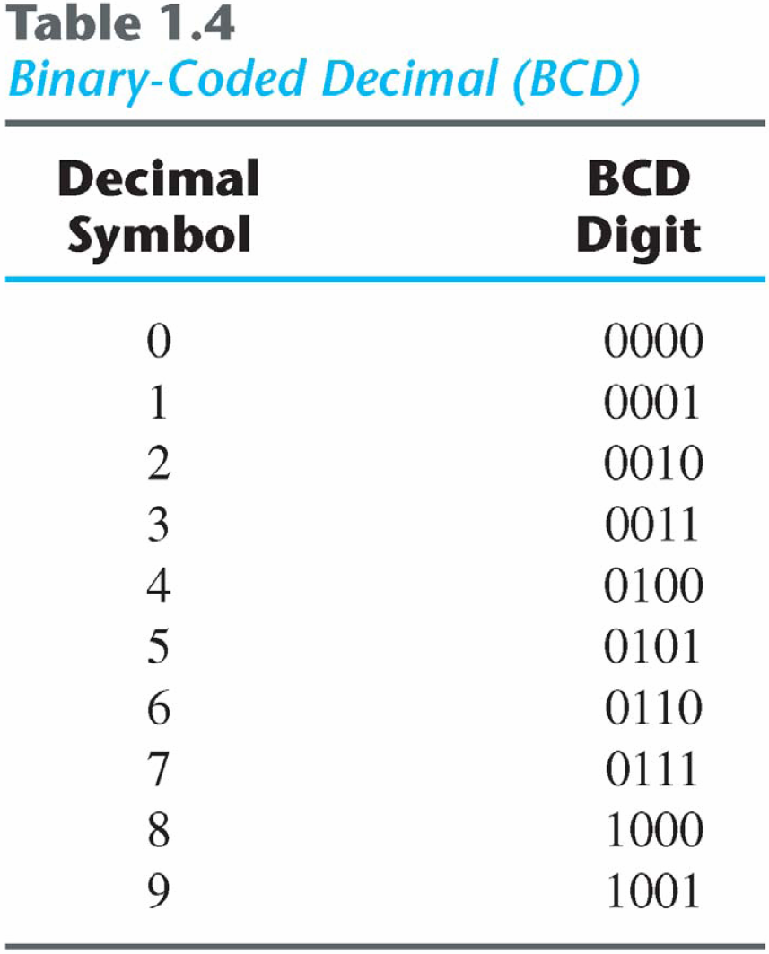
Binary Code: BCD Code
A number with k decimal digits will require 4k bits in BCD.
A decimal number in BCD is the same as its equivalent binary number only when the number is between 0 and 9.

Slide 48
Binary Code: BCD Code
BCD Addition

Slide 49
Binary Code: BCD Code
Example:
Consider the addition of 184 + 576 = 760 in BCD:

Slide 50
Binary Code: BCD Code
Decimal Arithmetic: (+375) + (-240) = +135

Slide 51
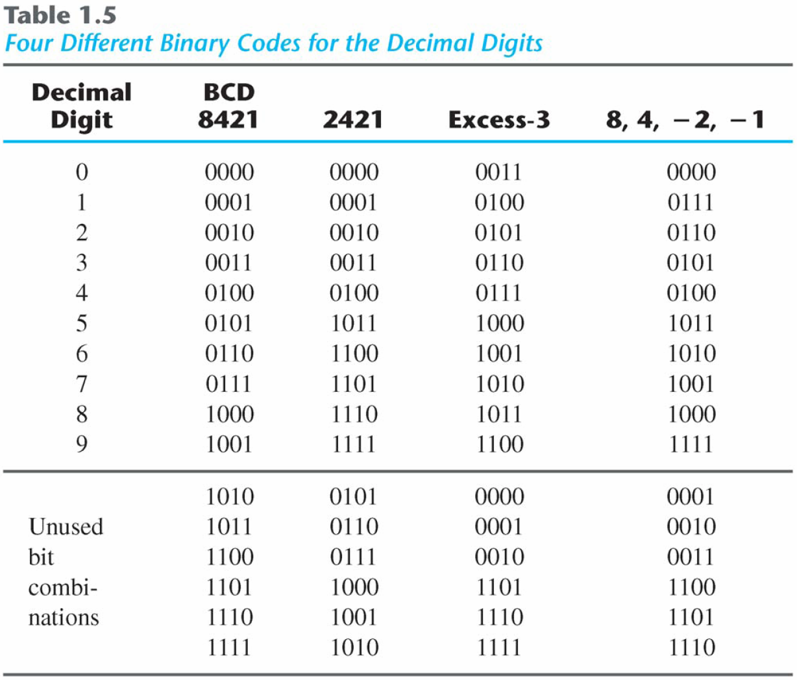
Binary Codes Other decimal codes

Slide 52
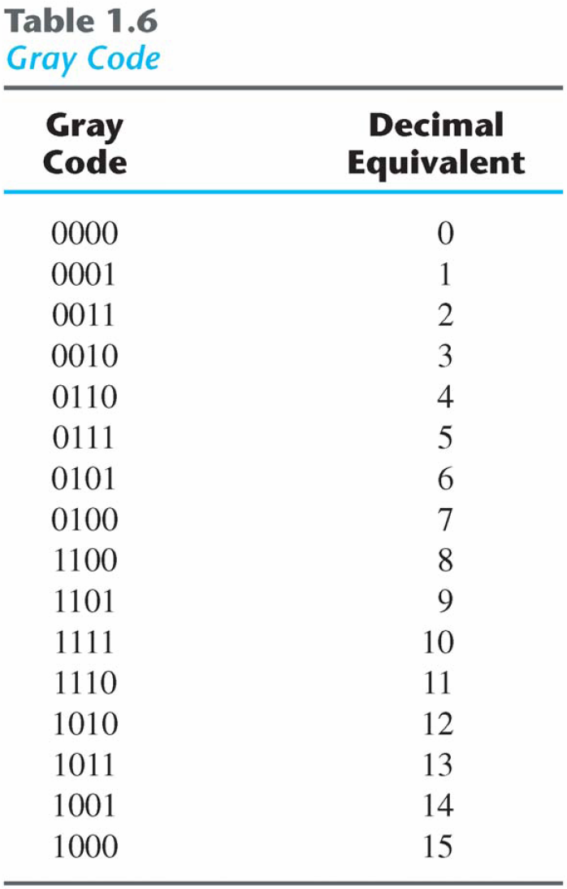
Binary Code: Gray Code

Slide 53
Binary Codes: ASCII Character Code
American Standard Code for Information Interchange (Refer to Table 1.7)
A popular code used to represent information sent as character-based data.
It uses 7-bits to represent:
94 Graphic printing characters.
34 Non-printing characters.
Some non-printing characters are used for text format (e.g. BS = Backspace, CR = carriage return).
Other non-printing characters are used for record marking and flow control (e.g. STX and ETX start and end text areas).

Slide 54
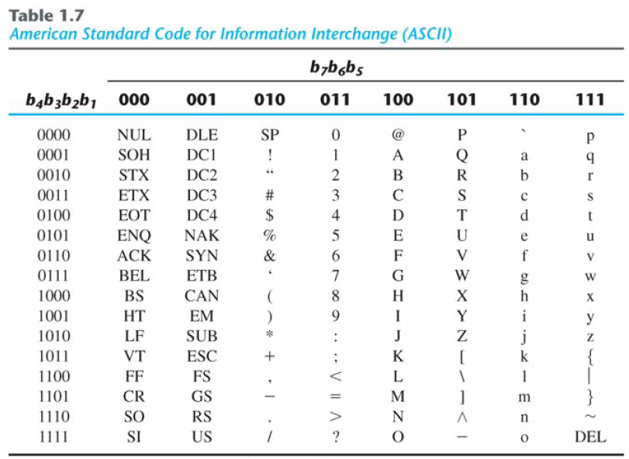
Binary Codes: ASCII Character Code

Slide 55
Binary Codes: Error-Detecting Code
To detect errors in data communication and processing, an eighth bit is sometimes added to the ASCII character to indicate its parity.
A parity bit is an extra bit included with a message to make the total number of 1's either even or odd.
Example:
Consider the following two characters and their even and odd parity:

Slide 56
Logic Gates
Figure 2.5 Digital logic gates

Slide 57
Logic Gates
Figure 2.5 Digital logic gates

Slide 58
Practice: Truth table to Boolean Function
x | y | z | F
0 | 0 | 0 | 0
0 | 0 | 1 | 0
0 | 1 | 0 | 1
0 | 1 | 1 | 1
1 | 0 | 0 | 0
1 | 0 | 1 | 0
1 | 1 | 0 | 1
1 | 1 | 1 | 1
F = xyz + xyz’+ x'yz + x'yz’
= y

Slide 59
Syllabus
Chapter 1 (Excluding Section 1.8)

